Slide 1
Capstone Project
Insurance Customer Response Prediction

Slide 2

Insurance Customer Response Prediction
“This project aims to leverage machine learning to predict customer responses to insurance policy offers, based on customer and policy features. Understanding customer behavior is critical in the insurance industry, as it directly impacts the effectiveness of targeted marketing and sales strategies. By analyzing customer demographics, vehicle information, and past behavior, we seek to build a robust model that can accurately forecast the likelihood of a positive customer response.”

Slide 3
Introduction
Problem Statement
Data Overview
Exploratory Data Analysis (EDA)
Model Selection
Model Evaluation
Conclusion
Thank you

Slide 4
Introduction
This project is focused on Vehicle Insurance cross-sales by a health insurance company. The Health Insurance company guarantees compensation for damage to a person’s health, loss of life and any property loss incurred. They now aim to leverage their customer and prospect data repository to cross-sell a vehicle insurance product. This is a continuous cycle that allows the company to follow the customer from more avenues. How to design a product that will win over most customers in this area is the business problem that we are trying to address. The case provides some data that has been generated from their beta market tests to develop an understanding of their customer responsiveness to the new vehicle insurance product based on certain identifying demographics.

Slide 5

Importance of understanding customer behavior for targeted marketing.
This case is being approached as a predictive analytics data mining problem. The steps we will follow to classify customers into viable candidates for cross-selling are based on the positive, or negative responses generated by their existing customers. A host of supervised and unsupervised classification algorithms will be trained on the data provided in this case study, treating their logged responses to the new vehicle insurance product as the target variable (yes/no to purchasing the product). The report below details the attributes of the dataset, feature engineering and data munging applied to the dataset and classification algorithms used in generating predictions to classify customers based on their responses

Slide 6
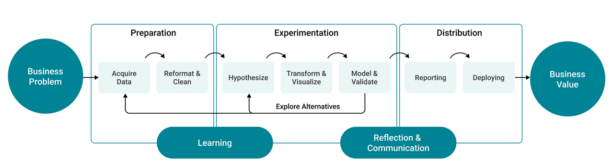
Project Workflow

Slide 7
Problem Statement
The challenge of predicting whether a customer will respond positively to insurance offers.
How solving this can improve marketing strategies and customer retention.

Slide 8
Data Collection
Description: Contains customer information on whether the policyholders (customers) from past year will be interested in buying the Vehicle Insurance provided by the company.
Columns: Includes customer details, services used, vehicle details, and response.
Purpose: Used for customer churn analysis, segmentation, and retention strategies.
Applications: Churn prediction, customer satisfaction analysis, and targeted marketing.
Analysis Tasks: EDA, data preprocessing, ML model building, evaluation, and model deployment.

Slide 9
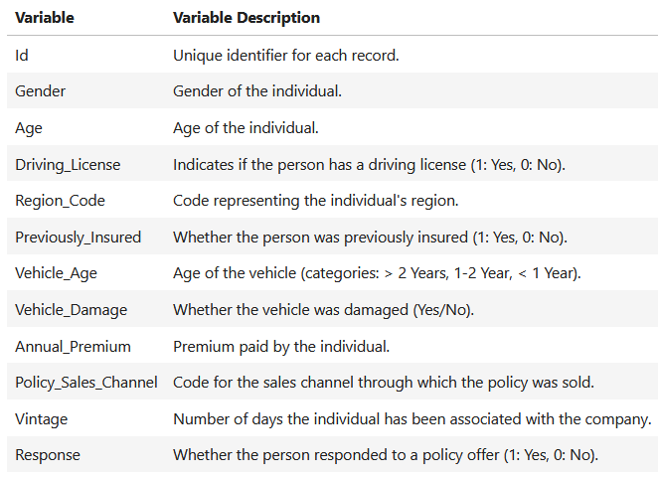
Data Overview

Slide 10
Exploratory Data Analysis (EDA)
To analyze the variables, some of the important libraries used in the project are numpy, pandas, matlotlib, seaborn sklearn, etc.
To know the dataset better, we need to know the relationship of variables with the target variable.
Eliminating / dumping unnecessary variables is an important part of data cleaning.
As part of the analysis, 'ID' does not play much significant role for better performance of algorithms in training and testing data set.

Slide 11
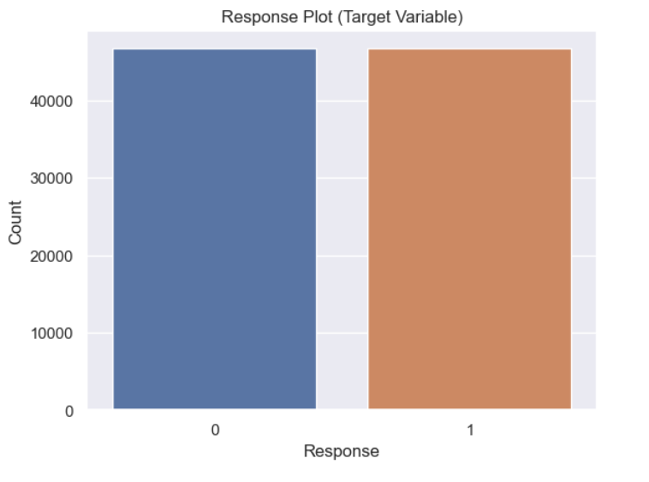
Target variable (Response Plot)

Slide 12
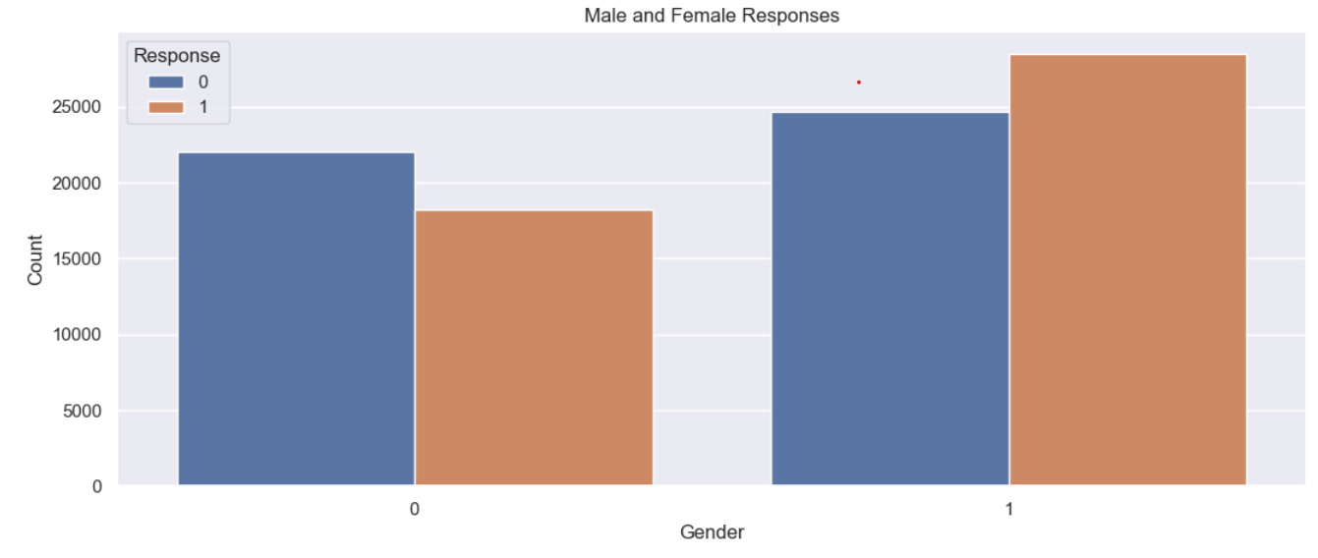
Gender variable
(Male and Female Responses)

Slide 13
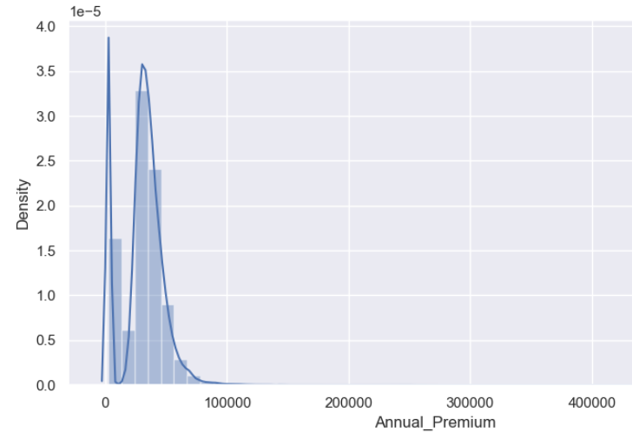
Distribution Plot for Annual Premium

Slide 14
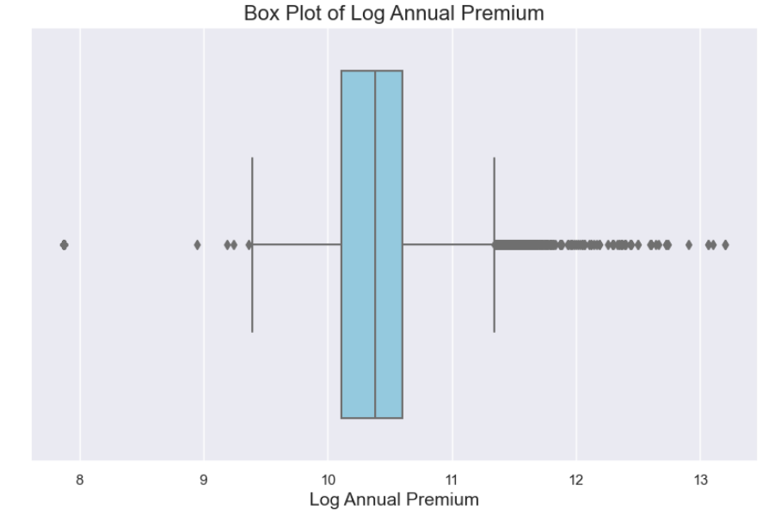

Slide 15
Model Selection
Models used:
Logistic Regression
Decision Tree Classifier
Random Forest Classifier

Slide 16
Logistic Regression: Logistic Regression is commonly used for binary classification problems. it's preferred because it provides a simple and efficient way to model the relationship between the independent variables and the probability of a certain outcome.
Decision Tree: Decision Tree algorithms are used for classification because they are simple, computationally efficient, and effective in handling high-dimensional data.
Random Forest Algorithm: Random Forest: Random Forest is a robust supervised algorithm suitable for both regression and classification tasks.

Slide 17
Model Evaluation
Evaluation metrics used
Accuracy
Precision
Recall
F1-score

Slide 18
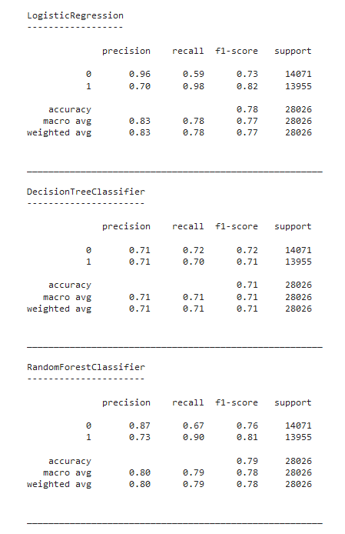
Model Comparison

Slide 19

Experimental Results :
The results of the experiment in the notebook involve three different classifiers for predicting insurance customer responses: Logistic Regression, Decision Tree Classifier, and Random Forest Classifier. Here's a summary of the performance metrics:
Logistic Regression:
Precision (0): 0.96, Recall (0): 0.59
Precision (1): 0.70, Recall (1): 0.98
Accuracy: 78%
Decision Tree Classifier:
Precision (0): 0.71, Recall (0): 0.72
Precision (1): 0.71, Recall (1): 0.70
Accuracy: 71%
Random Forest Classifier:
Precision (0): 0.87, Recall (0): 0.67
Precision (1): 0.73, Recall (1): 0.90
Accuracy: 79%

Slide 20

Potential Business Impact
1. Cost Reduction
2. Increased Customer Acquisition
3. Revenue Growth
4. Competitive Advantage

Slide 21
Conclusion
In the comparison of three machine learning models for predicting customer responses in the insurance sector, the Random Forest Classifier emerged as the best-performing model with an accuracy of 79%. It also achieved a balanced performance across precision and recall, making it the most reliable model for this classification task.
Logistic Regression achieved an accuracy of 78%, with higher precision but lower recall.
Decision Tree had a lower accuracy of 71%, showing consistent performance but not as strong as the Random Forest.
The Random Forest model offers a robust solution for predicting customer responses, balancing precision and recall effectively for both positive and negative classes.

Slide 22
Thank You!

